Slide 1
Rental shop analysis
By: Krushna Satyanarayan Takey
From: NIIT

Slide 2
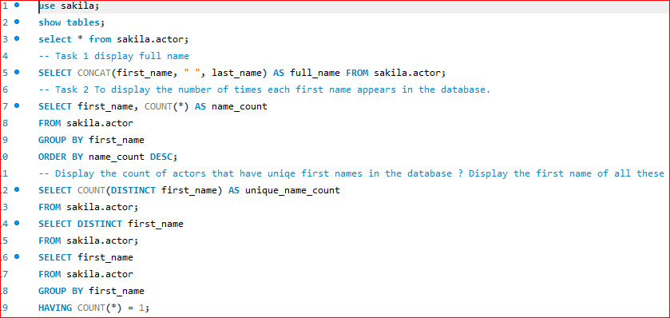
Task 1: Display the full names of actors available in the database.
Task2: Management wants to know if there are any names of the actors appearing frequently.
Display the number of times each first name appears in the database.
ii. What is the count of actors that have unique first names in the database? Display the firs names of all these actors

Slide 3
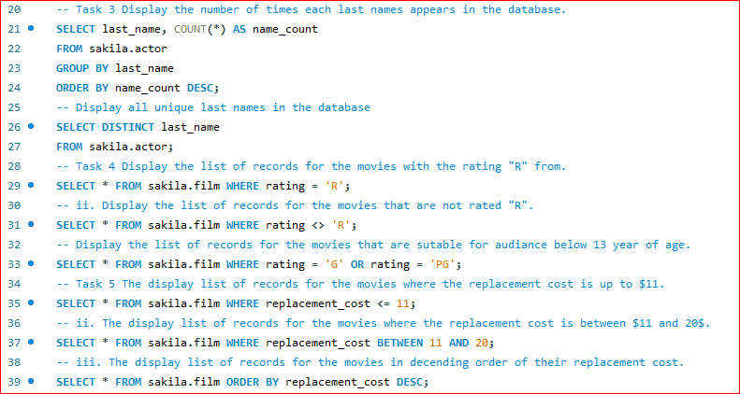
Task 3: Themanagement is interested to analyze the similiarity in the last names of the actors.
i. Display the number of times each last name appears in the database.ii. Display all unique last names in the database.
Task 4: The management wants to analyze the movies based on their ratings to determine if they are suitable for kids or some parental assistance is required. Perform the following tasks to perform the required analysis.
Display the list of records for the movies with the rating "R". (The movies with the rating "R" are not suitable for audience under 17 years of age).
ii. Display the list of records for the movies that are not rated "R".
iii. Display the list of records for the movies that are suitable for audience below 13 years of age.

Slide 4
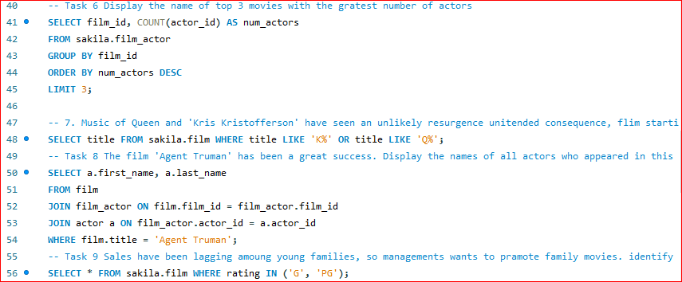
Task 5: The board members want to understand the replacement cost of a movie copy(disc-DVD/Blue replacement cost refers to the amount charged to the customer if the movie disc is not returned or is returned in a damaged state. the replacement cost is between $11 and $20.Ray). Thei. Display the list of records
ii. Display the list ofiii. Display the list offor the movies where the replacement cost is up to $11. records for the movies whererecords for the all movies in descending order of their replacement costs. Task 6: Display the names of the top 3 movies with the greatest number of actors.
Task 7: 'Music of Queen' 'Kris Kristofferson' have seen an unlikely resurgence.
andconsequence, films startingthe movies starting with thewith the letters 'K' and 'Q' have also soared in popularity. Display the titles of letters 'K' and 'Q.

Slide 5
Task 8: The film 'Agent Truman' has been a great success. Display the names of all actors who appeared in this film.
Task 9: Sales have been lagging among young families, so the management wants to promote family movies. Identify all the movies categorized as family films.
Task 10: The management wants to observe the rental rates and rental frequencies(Number of time the movie disc is rented).Display the maximum, minimum, and average rental rates of movies based on their ratings. The output must be sorted in descending order of the average rental rates.
i. Display the movies in descending order of their rental frequencies, so the management can maintain more copies of those movies

Slide 6
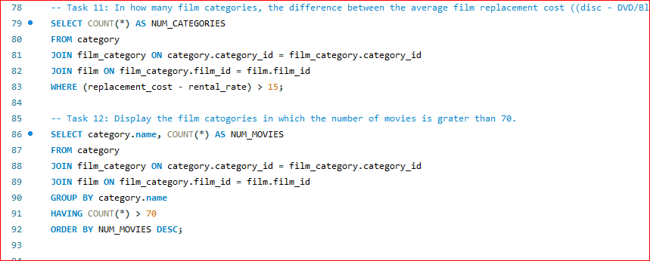
Task 11: In how many film categories, the difference between the average film replacement cost ((disc - DVD/Blue Ray) and the average film rental rate is greater than $15? Display the list of all film categories identified above, along with the corresponding average film rental rate
Task 12: Display the film categories in which the number of movies is greater than 70.
LINK

Slide 7
Conclusion: Business growth requires a clear vision, innovation, a strong team, customer focus, and adaptability. Common growth strategies include expanding markets, developing new products, acquiring businesses, and forming partnerships.

Slide 8
Thank you

